Slide 1
Big Data Group Project
FIT5202 | Assignment 2 | Group 11

Slide 2
Introduction of Members
Jemal Mohammed-Nour (Introduction to dataset)
Darragh Brendan Ruddy (Data cleaning)
Alec David Vukovich (Machine learning)
Myrnelle Jover (Results)
Matija Zivkovic (Challenges)
Notes:
Jemal

Slide 3
Introduction to data
The dataset consists of kickstarter campaigns from the popular crowdfunding platform.
Publicly available on kaggle
Dataset contains 331,465 records and 13 to 15 features
The aim is for a large number of people to pledge small amounts of money to achieve a specified funding goal.
Successful campaign is one that meets its funding goals
Ks-projects-201801.csv
Dataset URL https://www.kaggle.com/kemical/kickstarter-projects
Notes:
Jemal

Slide 4
Project objectives
The project aims to explore the variables which contribute to a successful project by
Achieving the funding goal or
Raising a large amount of money relative to similar projects.
Ultimately this project will identify the “recipe” for a kickstarter project which gives it the best chance of success.
Notes:
Jemal

Slide 5
Methodology
Project methodology summarised below.
Project Proposal
Data wrangling
Perform EDA on the cleaned dataset
Features transformation such that it is ready for machine learning
ML - Supervised classification model was implemented
ML Tuning
Model selection
Model evaluation
Notes:
Jemal

Slide 6
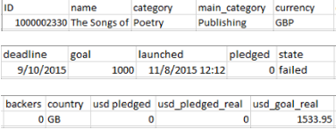
Cleaning Pipeline
We initially had two datasets, 2016 and 2018
Through EDA, we found that 2016 is a subset of 2018 data
The 2018 input features were:
Categorical:
Strings:
name
category
main category
Currency
state (target)
Country
Numeric:
ID number
Raw data in CSV
Notes:
Darragh

Slide 7
Numerical
Discrete
launched (date)
deadline (date)
backers (total number)
Continuous
pledged (local currency)
goal (local currency)
usd_goal_real (goal in USD)
usd pledged (KS data pledged in USD)
usd_pledged_real (Calculated data pledged in USD)
Original KS data for usd pledged was incorrect in many records. Author of dataset corrected the errors by using a currency conversion API.

Slide 8
Pipeline Methodology
Detailed explanation/justification of EDA in phase 2 report
To begin the pipeline our data CSVs are read into HDFS
Imported as dataframe into Spark
Key issues handled in the cleaning pipeline:
Dropping redundant columns, e.g.,
ID
Usd_pledged
Preprocessing data for ML pipeline
Dates split into month and year and total duration in days
Binning values, e.g.,
Discrete name lengths
Continuous values into discrete bins

Slide 9
Pipeline Methodology continued
Dealing with null values and invalid records, e.g.,
Nulls in discretized name lengths imputed as zero
Records with launched dates after deadline dates dropped
Records for target variable dropped if not either “successful” or “failed”
Records dropped for invalid countries, currencies
In our original phase 2 pipeline we encoded all of our features into binary
We reconsidered this approach in phase 3 and implemented indexing and encoding as part of the ML pipeline
Finally, we wrapped all of our code into functions
The functions are run sequentially in a pipeline
Output is a preprocessed dataframe for the ML pipeline.

Slide 10
Machine learning models
Identified the problem as binary classification
Three model classes were investigated
 | Logistic Regression | Gradient Boosted Tree | Support Vector Classifier
Description | Single probability threshold to classify 0/1 | Multiple threshold decisions to classify 0/1 | Threshold calculated in higher dimensions
Positives | Simple model | Performs well on imbalanced data | Outlier detection - use for class imbalance
Negatives | Can have issues with imbalanced classes | Can have issues with runtime performance | Can have issues with runtime performance

Slide 11
Machine learning Pipeline
One-hot encoded categorical features
Selection of best model
Cross validation and parameter grids to optimise model parameters
Timing the models to fit the data
Logistic regression was determined as the best model
Used the best model in the final pipeline
Cache to optimise run time
Notes:
Alec

Slide 12
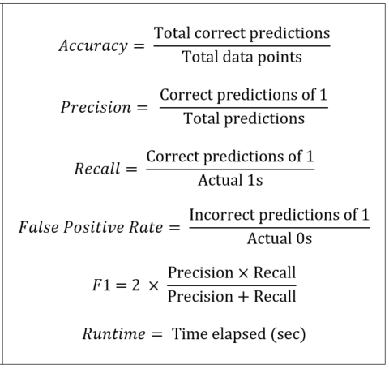
Evaluation metrics
Metrics calculated from confusion matrix
Need to balance metrics:
High accuracy: model not generalisable
Low accuracy: model is not predictive
Low precision: incorrectly predicted 1s
Low recall: incorrectly predicted 0s
Precision and recall are inversely related
Issues with imbalanced classes
F1-score eliminates trade-off
Runtime measures the practicality of using the model in real-world business applications
Ideal model:
Maximises F1
Minimises false positive rate
Minimises runtime
Notes:
Myrnelle

Slide 13
Expected results
Fastest model: Logistic Regression
Simplest model
No runtime issues
Most accurate model: Support Vector Classifier
Can handle the imbalanced classes
Would not be efficient
Unnecessarily complicates model
Most metrically balanced: Gradient Boosted Tree
Can tune the number of decisions it makes with `maxDepth` parameter
Iteratively adds data to improve its base model
Performs well on imbalanced data

Slide 14
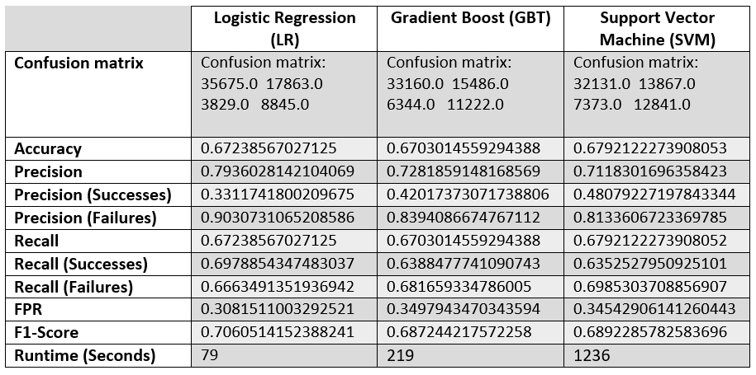
Actual results

Slide 15
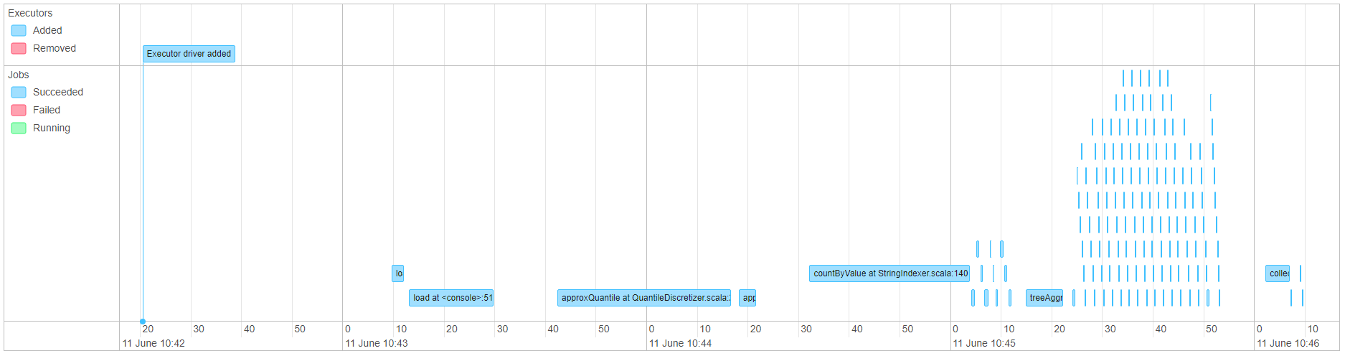
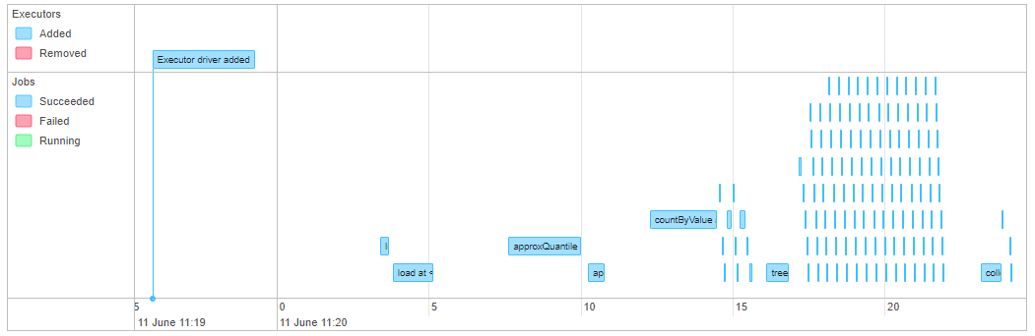
Challenges
Run time across different machines
Notes:
Matija

Slide 16
Challenges
Familiarity (or lack thereof) with Scala, Spark and Machine Learning
Lack of online support for Scala Spark API
Familiarity with Machine Learning and Modelling
Unfamiliar with Spark ML pipelining - had to rework phase 2 to compensate
PCA implementation, and visualisation support in Scala
Remote group work
Phase 2 - Coordination and Time Frame
Phase 3 - The need for an iterative approach

